Slide 1

Diabetes prediction using logistic regression
Huynh | Ravindra | Sood | Swamykannu

Slide 2
Agenda
Summary
Data Preparation
EDA
Variable selection and residual analysis
Model Validation
Model accuracy

Slide 3
Summary
PIMA Indian case study
Dataset
Summary Of Variables - Pregnancies, Glucose, Blood Pressure, Skinthickness, Insulin, Bmi, Diabetespedifreefunction, Age, Outcome

Slide 4
Data Preparation
Missing
Null, duplicate data
Outliers
Incorrect values
Impute data

Slide 5
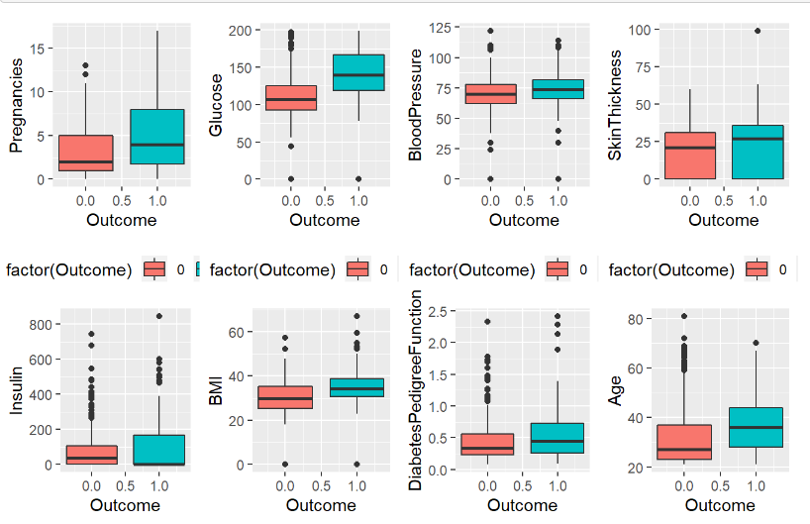
Boxplots

Slide 6
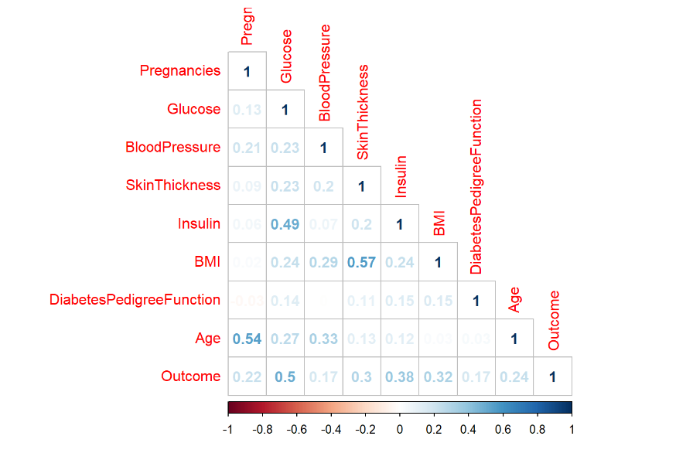
Correlation matrix

Slide 7
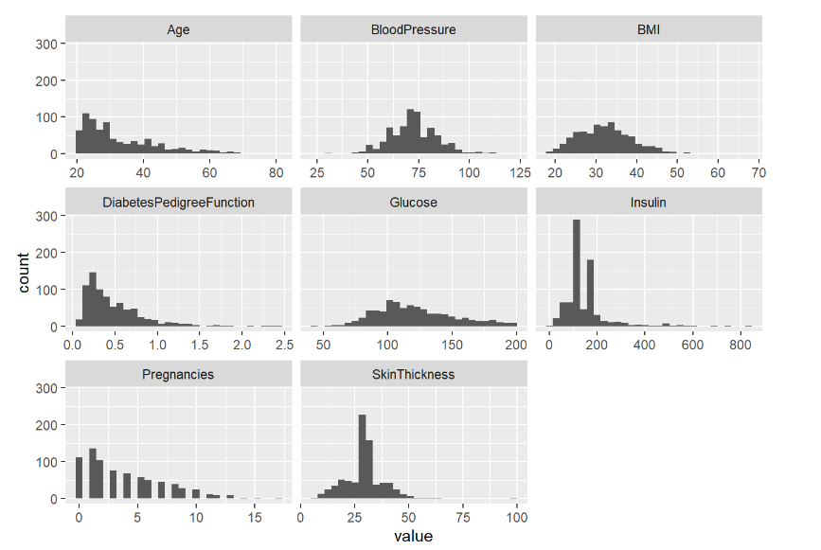
histogram

Slide 8
histogram

Slide 9
Model

Slide 10
Variable selection

Slide 11
Residual Analysis

Slide 12
Model validation

Slide 13
Model Accuracy

